Slide 1
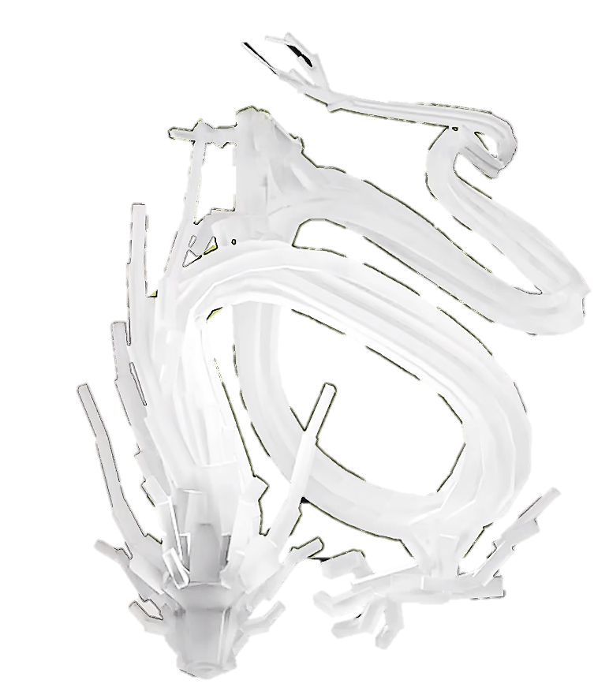


Traffic Flow Dynamic
Gong Ziyang

Slide 2

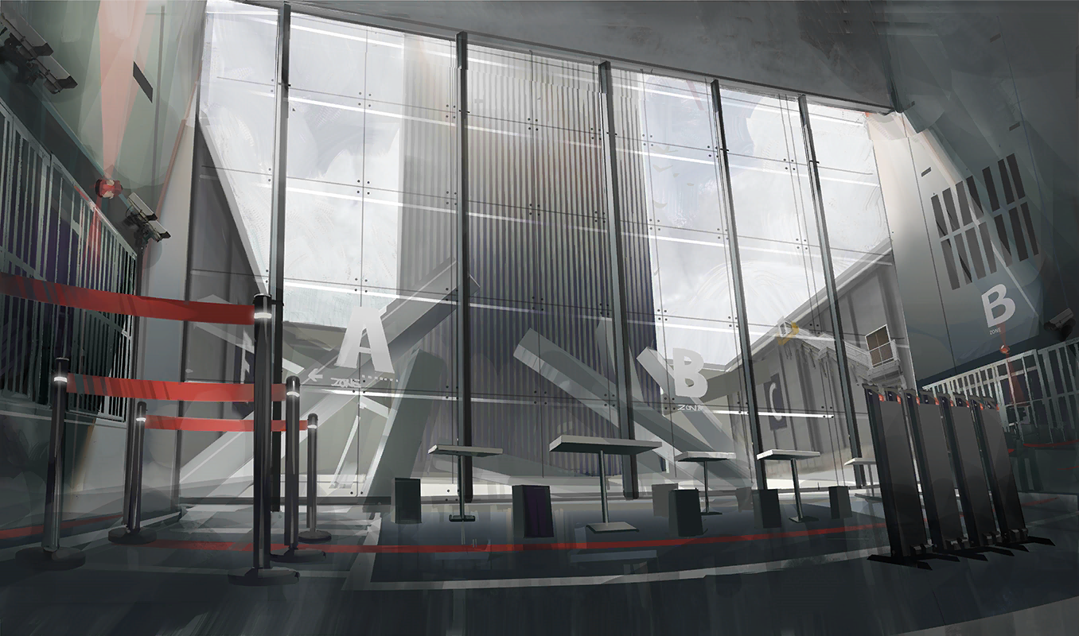
rhodeskesi
Chapt10.Modeling Human Aspects of Driving Behavio
建议使用：带图小标题
可以修改右侧文字 介绍
英文字体：Novecento wide
中文字体：思源黑体

Slide 3
12.1 Man Versus Machine
rhodeskesi
Human Limitations & Imperfections：
Finite Reaction Time
Estimation Errors
Perception Thresholds
Limited Attention Span & Distraction
Human Advantages & Cognitive Capabilities：
Multi-Stimuli Processing & Spatial Anticipation
Temporal Anticipation
Context Sensitivity & Memory Effect
Courtesy & Cooperation
Psycho-Physiological Car-Following Models：
Integrating physiological constraints with psychological strategies into the following model

Slide 4
12.2 Reaction Times
rhodeskesi
Reaction Time composed of three part：
Mental processing time：
The mental processing time, which is composed of the sensation time, the perception or recognition time, the "situation awareness time" needed to recognize and interpret the scene, and the decision time.
Movement or action time：
To lift the foot from the throttle pedal, move it to the brake pedal, and apply pressure.
Technical response time：
  The technical response time of the respective vehicle components
  Nearly all models and simulators assume a constant common value of the order of 1s for all drivers in all situations.

Slide 5
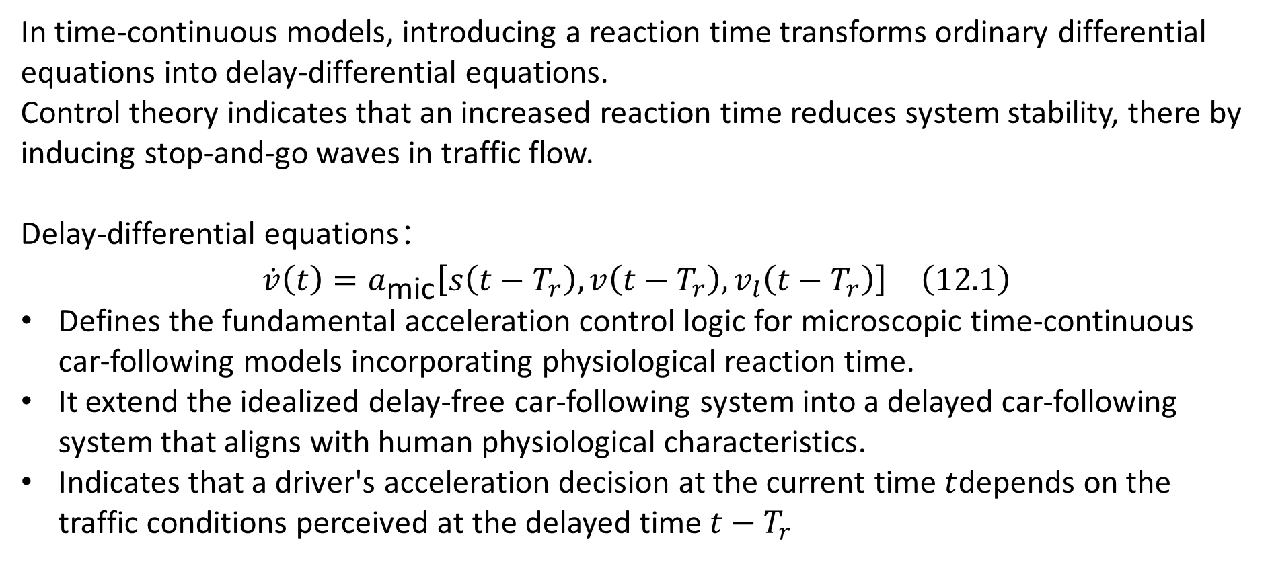
12.2 Reaction Times
rhodeskesi
  In time-continuous models, introducing a reaction time transforms ordinary differential equations into delay-differential equations.
  Control theory indicates that an increased reaction time reduces system stability, there by inducing stop-and-go waves in traffic flow.
Delay-differential equations：
$$\dot{v}\left(t\right)=a_{\text{mic}}\left[s\left(t−T_{r}\right),v\left(t−T_{r}\right),v_{l}\left(t−T_{r}\right)\right] \left(12.1\right)$$
Defines the fundamental acceleration control logic for microscopic time-continuous car-following models incorporating physiological reaction time.
It extend the idealized delay-free car-following system into a delayed car-following system that aligns with human physiological characteristics.
Indicates that a driver's acceleration decision at the current time $t$depends on the traffic conditions perceived at the delayed time $t−T_{r}$

Slide 6
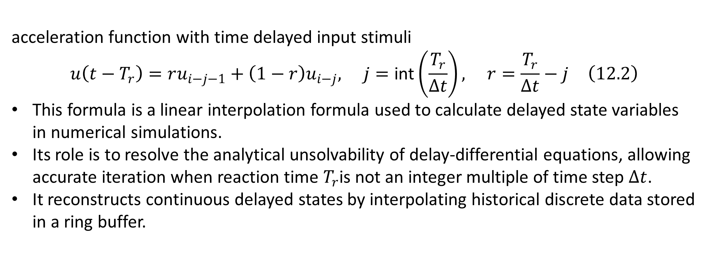
12.2 Reaction Times
rhodeskesi
  acceleration function with time delayed input stimuli
  $$u\left(t−T_{r}\right)=ru_{i−j−1}+\left(1−r\right)u_{i−j}, j=\text{int}\left(\frac{T_{r}}{Δt}\right), r=\frac{T_{r}}{Δt}−j \left(12.2\right)$$
This formula is a linear interpolation formula used to calculate delayed state variables in numerical simulations.
Its role is to resolve the analytical unsolvability of delay-differential equations, allowing accurate iteration when reaction time $T_{r}$is not an integer multiple of time step $Δt$.
It reconstructs continuous delayed states by interpolating historical discrete data stored in a ring buffer.

Slide 7
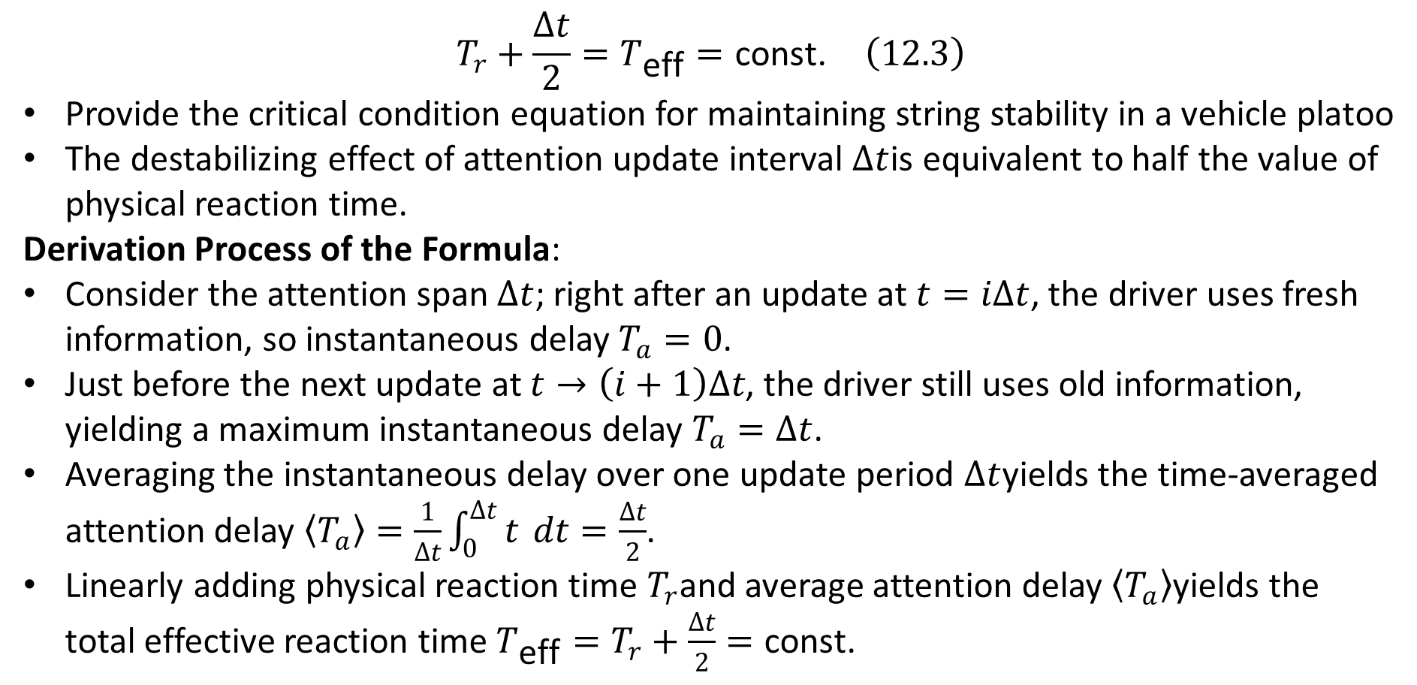
12.2 Reaction Times
rhodeskesi
  $$T_{r}+\frac{Δt}{2}=T_{\text{eff}}=\text{const.} \left(12.3\right)$$
Provide the critical condition equation for maintaining string stability in a vehicle platoo
The destabilizing effect of attention update interval $Δt$is equivalent to half the value of physical reaction time.
Derivation Process of the Formula:
Consider the attention span $Δt$; right after an update at $t=iΔt$, the driver uses fresh information, so instantaneous delay $T_{a}=0$.
Just before the next update at $t→\left(i+1\right)Δt$, the driver still uses old information, yielding a maximum instantaneous delay $T_{a}=Δt$.
Averaging the instantaneous delay over one update period $Δt$yields the time-averaged attention delay $\left\langle T_{a}\right\rangle =\frac{1}{Δt}\int_{0}^{Δt}{t} dt=\frac{Δt}{2}$.
Linearly adding physical reaction time $T_{r}$and average attention delay $\left\langle T_{a}\right\rangle$yields the total effective reaction time $T_{\text{eff}}=T_{r}+\frac{Δt}{2}=\text{const.}$

Slide 8
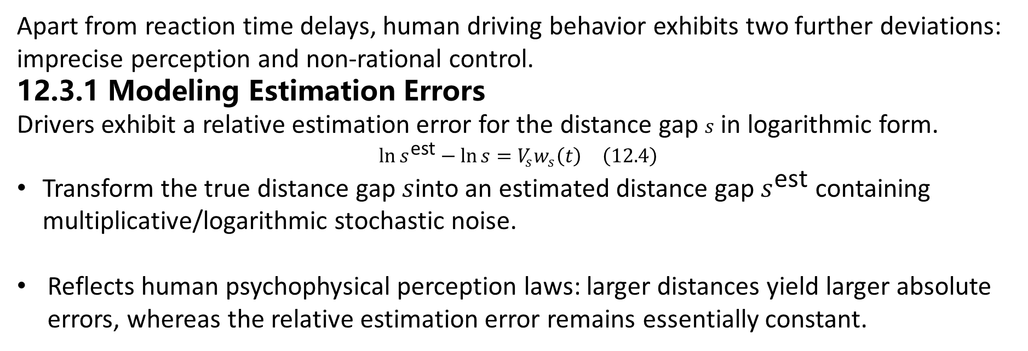
12.3 Estimation Errors and Imperfect Driving Capabilities
rhodeskesi
  Apart from reaction time delays, human driving behavior exhibits two further deviations: imprecise perception and non-rational control.
  12.3.1 Modeling Estimation Errors
  Drivers exhibit a relative estimation error for the distance gap $s$ in logarithmic form.
  $${\ln{s}}^{\text{est}}−\ln{s}=V_{s}w_{s}\left(t\right) \left(12.4\right)$$
  Transform the true distance gap $s$into an estimated distance gap $s^{\text{est}}$ containing multiplicative/logarithmic stochastic noise.
  Reflects human psychophysical perception laws: larger distances yield larger absolute errors, whereas the relative estimation error remains essentially constant.

Slide 9
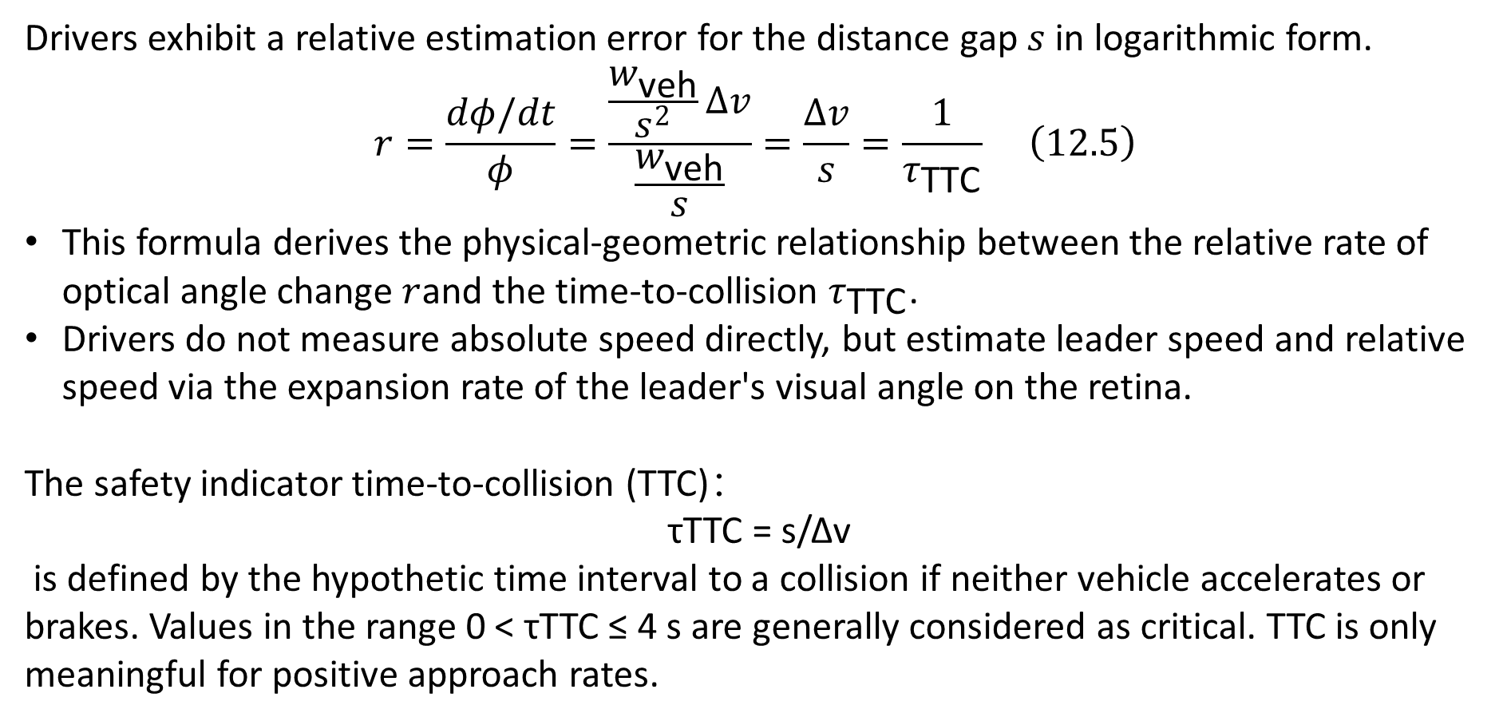
12.3.1 Modeling Estimation Errors
rhodeskesi
  Drivers exhibit a relative estimation error for the distance gap $s$ in logarithmic form.
  $$r=\frac{dφ/dt}{φ}=\frac{\frac{w_{\text{veh}}}{s^{2}}Δv}{\frac{w_{\text{veh}}}{s}}=\frac{Δv}{s}=\frac{1}{τ_{\text{TTC}}} \left(12.5\right)$$
  This formula derives the physical-geometric relationship between the relative rate of optical angle change $r$and the time-to-collision $τ_{\text{TTC}}$.
  Drivers do not measure absolute speed directly, but estimate leader speed and relative speed via the expansion rate of the leader's visual angle on the retina.
  The safety indicator time-to-collision (TTC)：
  τTTC = s/Δv
  is defined by the hypothetic time interval to a collision if neither vehicle accelerates or brakes. Values in the range 0 < τTTC ≤ 4 s are generally considered as critical. TTC is only meaningful for positive approach rates.

Slide 10
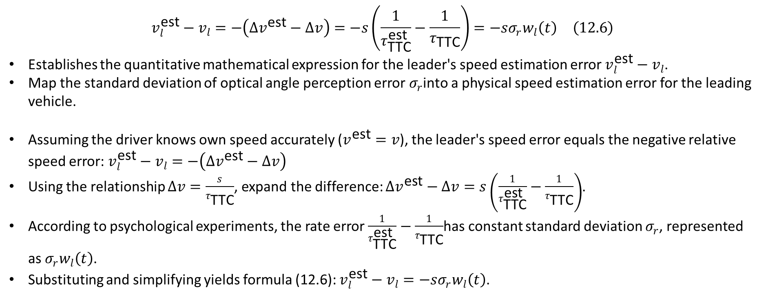
12.3.1 Modeling Estimation Errors
rhodeskesi
$$v_{l}^{\text{est}}−v_{l}=−\left(Δv^{\text{est}}−Δv\right)=−s\left(\frac{1}{τ_{\text{TTC}}^{\text{est}}}−\frac{1}{τ_{\text{TTC}}}\right)=−sσ_{r}w_{l}\left(t\right) \left(12.6\right)$$
  Establishes the quantitative mathematical expression for the leader's speed estimation error $v_{l}^{\text{est}}−v_{l}$.
  Map the standard deviation of optical angle perception error $σ_{r}$into a physical speed estimation error for the leading vehicle.
  Assuming the driver knows own speed accurately ($v^{\text{est}}=v$), the leader's speed error equals the negative relative speed error: $v_{l}^{\text{est}}−v_{l}=−\left(Δv^{\text{est}}−Δv\right)$
  Using the relationship $Δv=\frac{s}{τ_{\text{TTC}}}$, expand the difference: $Δv^{\text{est}}−Δv=s\left(\frac{1}{τ_{\text{TTC}}^{\text{est}}}−\frac{1}{τ_{\text{TTC}}}\right)$.
  According to psychological experiments, the rate error $\frac{1}{τ_{\text{TTC}}^{\text{est}}}−\frac{1}{τ_{\text{TTC}}}$has constant standard deviation $σ_{r}$, represented as $σ_{r}w_{l}\left(t\right)$.
  Substituting and simplifying yields formula (12.6): $v_{l}^{\text{est}}−v_{l}=−sσ_{r}w_{l}\left(t\right)$.

Slide 11
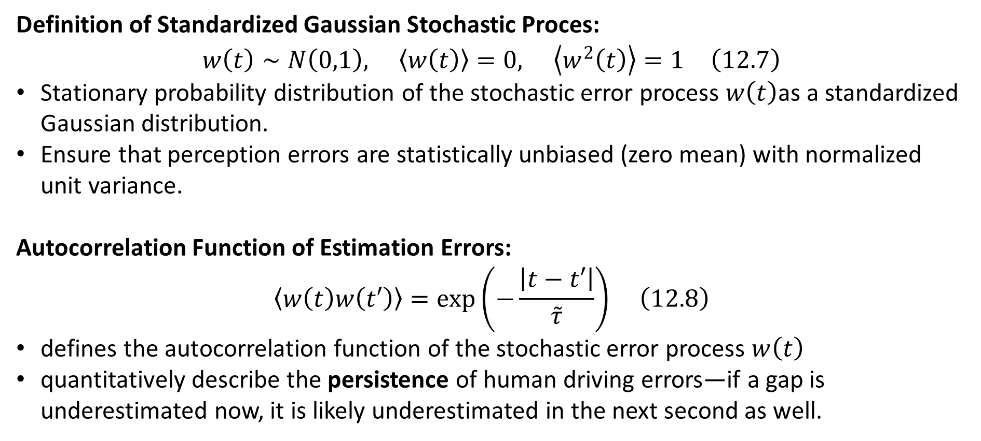
12.3.1 Modeling Estimation Errors
rhodeskesi
Definition of Standardized Gaussian Stochastic Proces:
$$w\left(t\right)∼N\left(0,1\right), \left\langle w\left(t\right)\right\rangle =0, \left\langle w^{2}\left(t\right)\right\rangle =1 \left(12.7\right)$$
  Stationary probability distribution of the stochastic error process $w\left(t\right)$as a standardized Gaussian distribution.
  Ensure that perception errors are statistically unbiased (zero mean) with normalized unit variance.
  Autocorrelation Function of Estimation Errors:
  $$\left\langle w\left(t\right)w\left(t′\right)\right\rangle =\exp\left(−\frac{\left|t−t′\right|}{\overset{˜}{τ}}\right) \left(12.8\right)$$
  defines the autocorrelation function of the stochastic error process $w\left(t\right)$
  quantitatively describe the persistence of human driving errors—if a gap is underestimated now, it is likely underestimated in the next second as well.

Slide 12
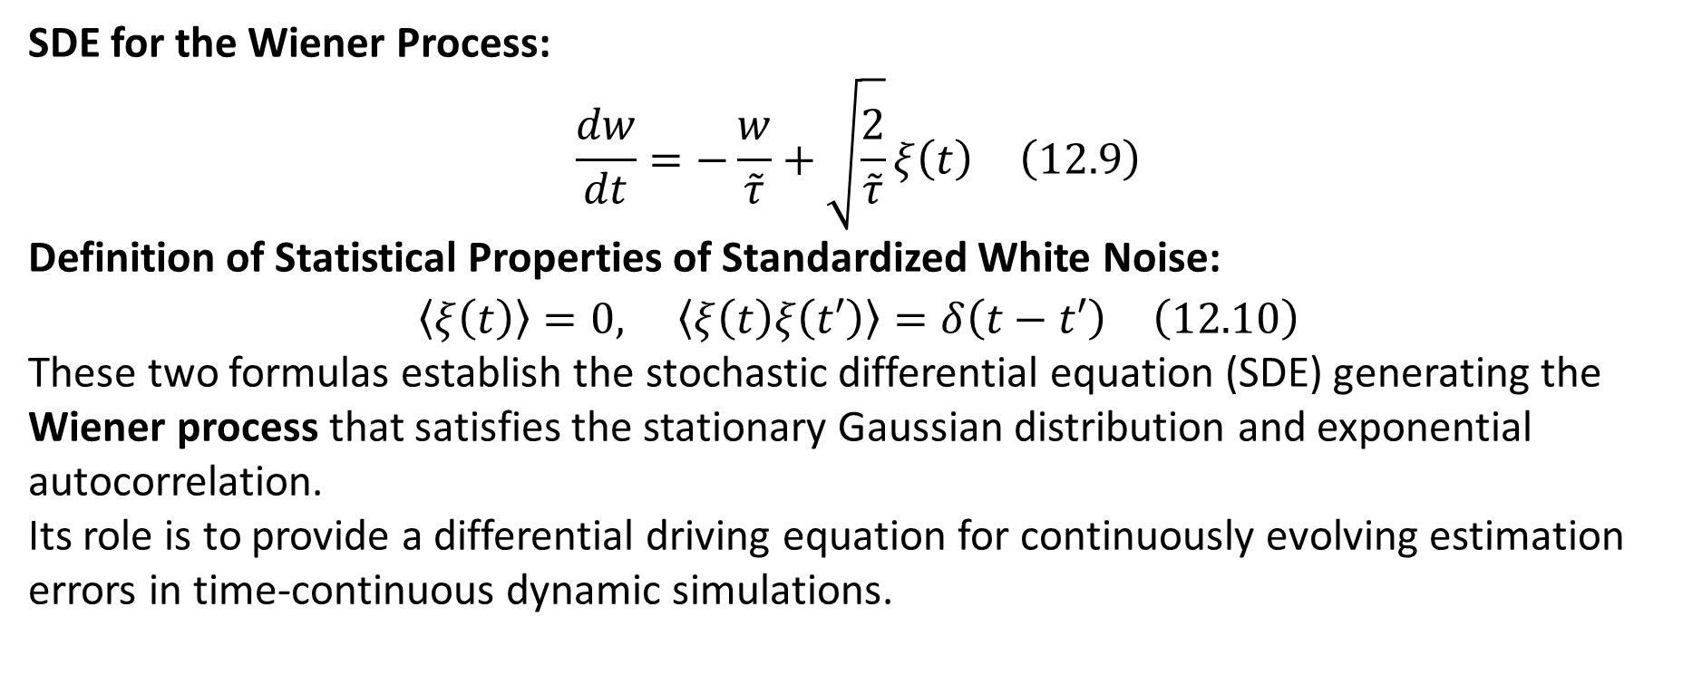
12.3.1 Modeling Estimation Errors
rhodeskesi
SDE for the Wiener Process:
$$\frac{dw}{dt}=−\frac{w}{\overset{˜}{τ}}+\sqrt{\frac{2}{\overset{˜}{τ}}}ξ\left(t\right) \left(12.9\right)$$
Definition of Statistical Properties of Standardized White Noise:
$$\left\langle ξ\left(t\right)\right\rangle =0, \left\langle ξ\left(t\right)ξ\left(t′\right)\right\rangle =δ\left(t−t′\right) \left(12.10\right)$$
These two formulas establish the stochastic differential equation (SDE) generating the Wiener process that satisfies the stationary Gaussian distribution and exponential autocorrelation.
Its role is to provide a differential driving equation for continuously evolving estimation errors in time-continuous dynamic simulations.

Slide 13
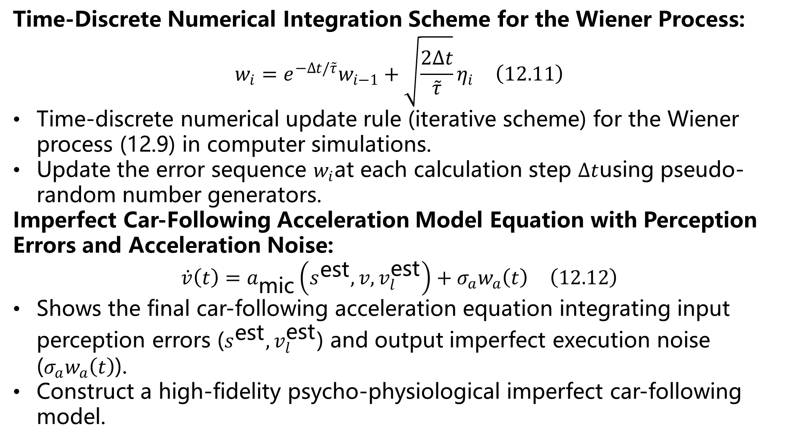
12.3 Modeling Estimation Errors
Time-Discrete Numerical Integration Scheme for the Wiener Process:
$$w_{i}=e^{−Δt/\overset{˜}{τ}}w_{i−1}+\sqrt{\frac{2Δt}{\overset{˜}{τ}}}η_{i} \left(12.11\right)$$
Time-discrete numerical update rule (iterative scheme) for the Wiener process (12.9) in computer simulations.
Update the error sequence $w_{i}$at each calculation step $Δt$using pseudo-random number generators.
Imperfect Car-Following Acceleration Model Equation with Perception Errors and Acceleration Noise:
$$\dot{v}\left(t\right)=a_{\text{mic}}\left(s^{\text{est}},v,v_{l}^{\text{est}}\right)+σ_{a}w_{a}\left(t\right) \left(12.12\right)$$
Shows the final car-following acceleration equation integrating input perception errors ($s^{\text{est}},v_{l}^{\text{est}}$) and output imperfect execution noise ($σ_{a}w_{a}\left(t\right)$).
Construct a high-fidelity psycho-physiological imperfect car-following model.
rhodeskesi

Slide 14
12.4 Temporal Anticipation
  Simulations show that ACC-like car-following models with reaction-time delays are highly prone to crashes at small gaps.
  In reality, however, human drivers remain crash-free and oscillation-free even when the average time gap is smaller than the reaction time.
  This stability stems from drivers' forward-looking anticipation heuristics for traffic conditions in the next few seconds.
  Drivers adopt a "constant-acceleration heuristic" for their own vehicle, performing a linear forward projection of speed.
  Drivers adopt a "constant-speed heuristic" for the leading vehicle, thereby proactively estimating the future distance gap.
rhodeskesi

Slide 15
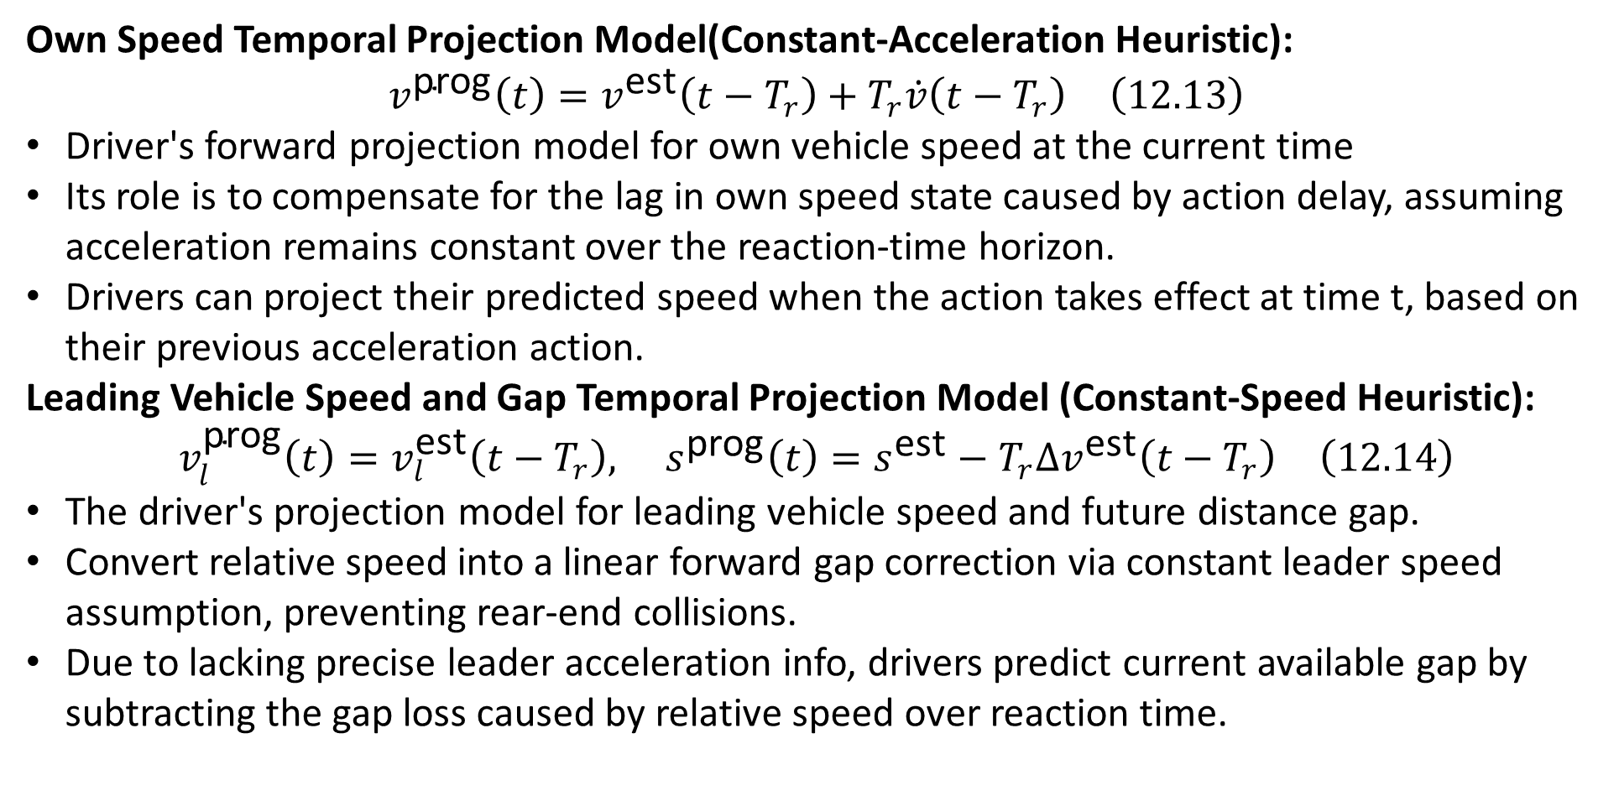
12.4 Temporal Anticipation
  Own Speed Temporal Projection Model(Constant-Acceleration Heuristic):
  $$v^{\text{prog}}\left(t\right)=v^{\text{est}}\left(t−T_{r}\right)+T_{r}\dot{v}\left(t−T_{r}\right) \left(12.13\right)$$
  Driver's forward projection model for own vehicle speed at the current time
  Its role is to compensate for the lag in own speed state caused by action delay, assuming acceleration remains constant over the reaction-time horizon.
  Drivers can project their predicted speed when the action takes effect at time t, based on their previous acceleration action.
  Leading Vehicle Speed and Gap Temporal Projection Model (Constant-Speed Heuristic):
  $$v_{l}^{\text{prog}}\left(t\right)=v_{l}^{\text{est}}\left(t−T_{r}\right), s^{\text{prog}}\left(t\right)=s^{\text{est}}−T_{r}Δv^{\text{est}}\left(t−T_{r}\right) \left(12.14\right)$$
  The driver's projection model for leading vehicle speed and future distance gap.
  Convert relative speed into a linear forward gap correction via constant leader speed assumption, preventing rear-end collisions.
  Due to lacking precise leader acceleration info, drivers predict current available gap by subtracting the gap loss caused by relative speed over reaction time.
rhodeskesi

Slide 16
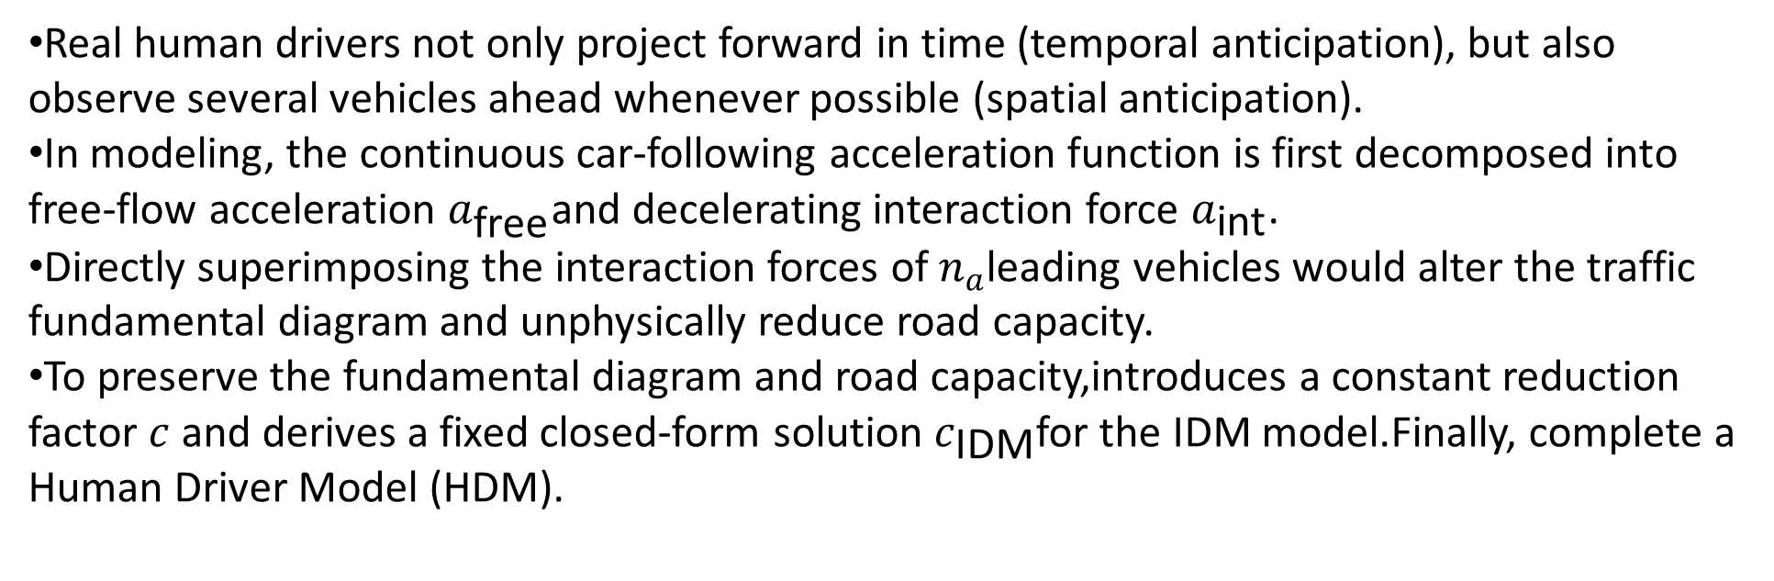
12.5 Multi-Vehicle Anticipation
  Real human drivers not only project forward in time (temporal anticipation), but also observe several vehicles ahead whenever possible (spatial anticipation).
  In modeling, the continuous car-following acceleration function is first decomposed into free-flow acceleration $a_{\text{free}}$and decelerating interaction force $a_{\text{int}}$.
  Directly superimposing the interaction forces of $n_{a}$leading vehicles would alter the traffic fundamental diagram and unphysically reduce road capacity.
  To preserve the fundamental diagram and road capacity,introduces a constant reduction factor $c$ and derives a fixed closed-form solution $c_{\text{IDM}}$for the IDM model.Finally, complete a Human Driver Model (HDM).
rhodeskesi

Slide 17
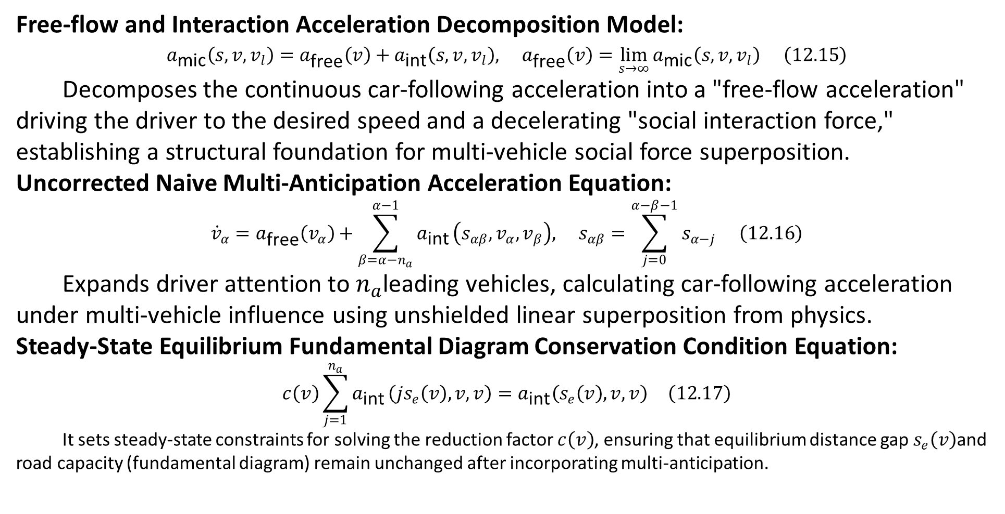
12.5 Multi-Vehicle Anticipation
  Free-flow and Interaction Acceleration Decomposition Model:
  $$a_{\text{mic}}\left(s,v,v_{l}\right)=a_{\text{free}}\left(v\right)+a_{\text{int}}\left(s,v,v_{l}\right), a_{\text{free}}\left(v\right)=\lim_{s→∞}{a_{\text{mic}}\left(s,v,v_{l}\right)} \left(12.15\right)$$
  Decomposes the continuous car-following acceleration into a "free-flow acceleration" driving the driver to the desired speed and a decelerating "social interaction force," establishing a structural foundation for multi-vehicle social force superposition.
  Uncorrected Naive Multi-Anticipation Acceleration Equation:
$${\dot{v}}_{α}=a_{\text{free}}\left(v_{α}\right)+\sum_{β=α−n_{a}}^{α−1}{a_{\text{int}}}\left(s_{αβ},v_{α},v_{β}\right), s_{αβ}=\sum_{j=0}^{α−β−1}{s_{α−j}} \left(12.16\right)$$
  Expands driver attention to $n_{a}$leading vehicles, calculating car-following acceleration under multi-vehicle influence using unshielded linear superposition from physics.
  Steady-State Equilibrium Fundamental Diagram Conservation Condition Equation:
$$c\left(v\right)\sum_{j=1}^{n_{a}}{a_{\text{int}}}\left(js_{e}\left(v\right),v,v\right)=a_{\text{int}}\left(s_{e}\left(v\right),v,v\right) \left(12.17\right)$$
It sets steady-state constraints for solving the reduction factor $c\left(v\right)$, ensuring that equilibrium distance gap $s_{e}\left(v\right)$and road capacity (fundamental diagram) remain unchanged after incorporating multi-anticipation.
rhodeskesi

Slide 18
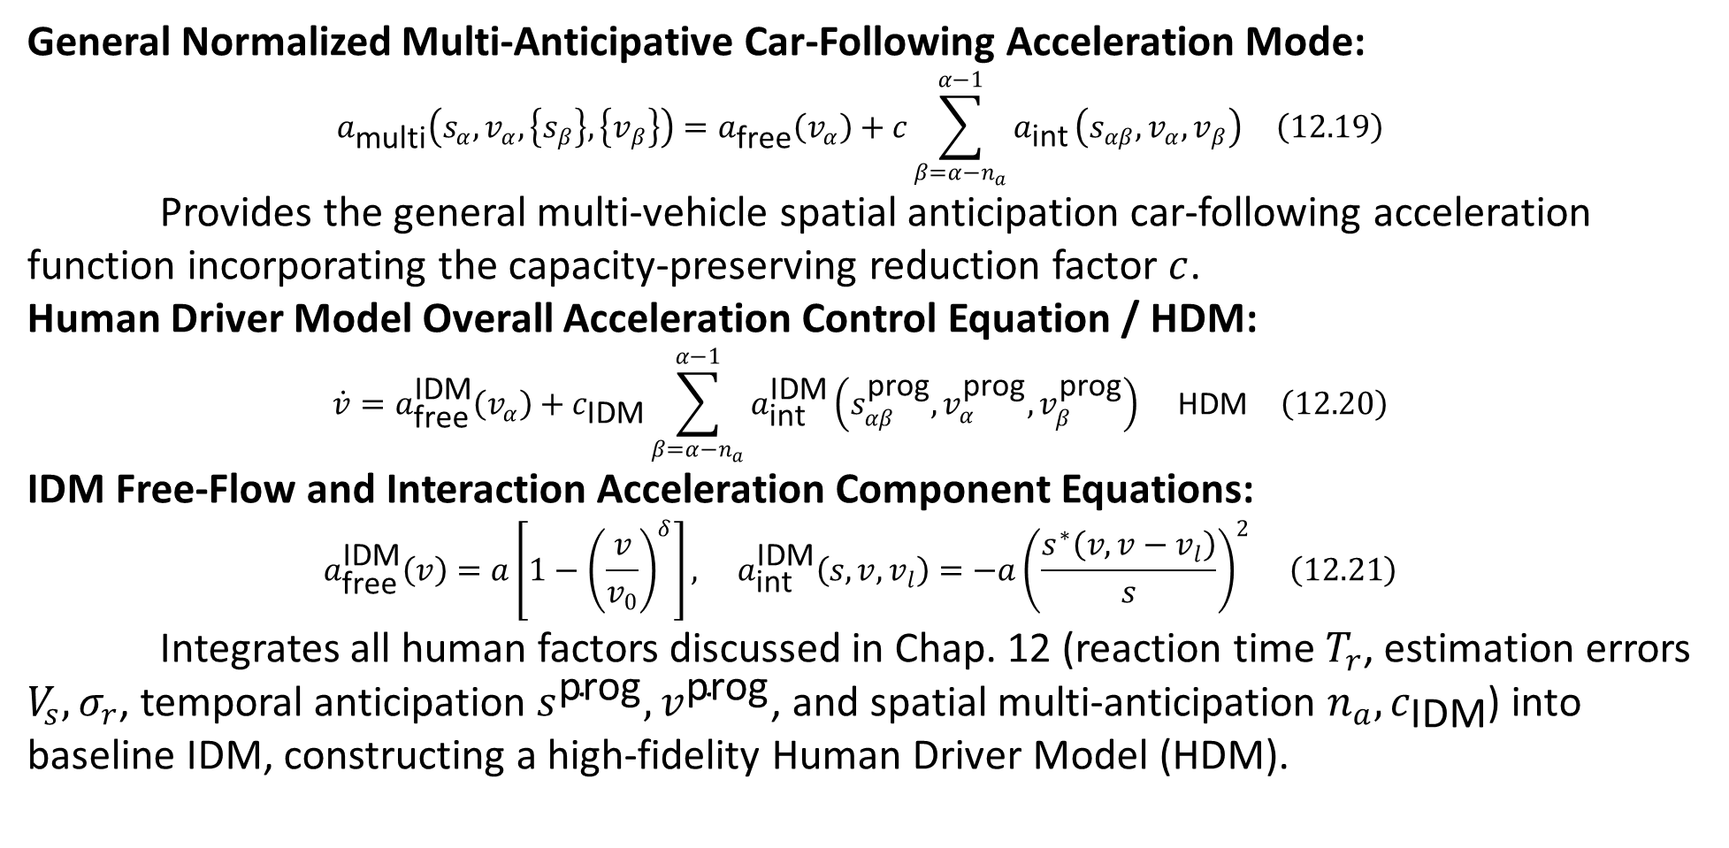
12.5 Multi-Vehicle Anticipation
General Normalized Multi-Anticipative Car-Following Acceleration Mode:
$$a_{\text{multi}}\left(s_{α},v_{α},\left\{s_{β}\right\},\left\{v_{β}\right\}\right)=a_{\text{free}}\left(v_{α}\right)+c\sum_{β=α−n_{a}}^{α−1}{a_{\text{int}}}\left(s_{αβ},v_{α},v_{β}\right) \left(12.19\right)$$
Provides the general multi-vehicle spatial anticipation car-following acceleration function incorporating the capacity-preserving reduction factor $c$.
Human Driver Model Overall Acceleration Control Equation / HDM:
$$\dot{v}=a_{\text{free}}^{\text{IDM}}\left(v_{α}\right)+c_{\text{IDM}}\sum_{β=α−n_{a}}^{α−1}{a_{\text{int}}^{\text{IDM}}}\left(s_{αβ}^{\text{prog}},v_{α}^{\text{prog}},v_{β}^{\text{prog}}\right) \text{HDM} \left(12.20\right)$$
IDM Free-Flow and Interaction Acceleration Component Equations:
$$a_{\text{free}}^{\text{IDM}}\left(v\right)=a\left[1−{\left(\frac{v}{v_{0}}\right)}^{δ}\right], a_{\text{int}}^{\text{IDM}}\left(s,v,v_{l}\right)=−a{\left(\frac{s^{∗}\left(v,v−v_{l}\right)}{s}\right)}^{2} \left(12.21\right)$$
Integrates all human factors discussed in Chap. 12 (reaction time $T_{r}$, estimation errors $V_{s},σ_{r}$, temporal anticipation $s^{\text{prog}},v^{\text{prog}}$, and spatial multi-anticipation $n_{a},c_{\text{IDM}}$) into baseline IDM, constructing a high-fidelity Human Driver Model (HDM).
rhodeskesi

Slide 19
12.6 Brake Lights and Further Exogenous Factors
  Brake lights, as a binary exogenous input variable, convey the leading vehicle's sharp deceleration intention to the follower.
  When the leader's brake lights turn on, the follower adapts to a more defensive driving mode, such as increasing the desired time gap T or reducing comfortable deceleration b.
  Tailgating behavior from the follower can also be represented by a binary exogenous variable, exerting a "forward social force" that urges the subject vehicle to accelerate or change lanes.
rhodeskesi

Slide 20
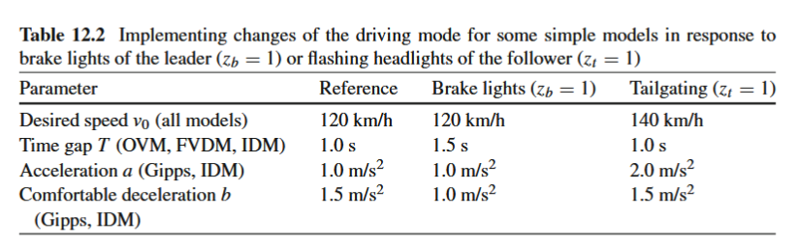
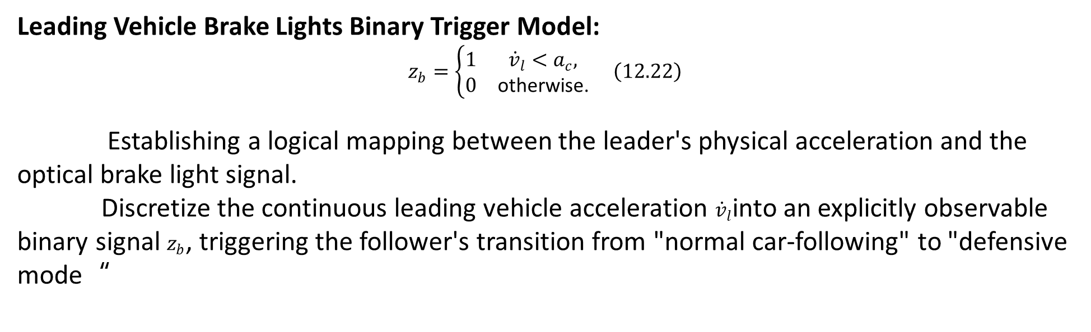
12.6 Brake Lights and Further Exogenous Factors
Leading Vehicle Brake Lights Binary Trigger Model:
$$z_{b}=\left\{\begin{matrix}1 & {\dot{v}}_{l}<a_{c}, \\ 0 & \text{otherwise.}\end{matrix}\right. \left(12.22\right)$$
Establishing a logical mapping between the leader's physical acceleration and the optical brake light signal.
Discretize the continuous leading vehicle acceleration ${\dot{v}}_{l}$into an explicitly observable binary signal $z_{b}$, triggering the follower's transition from "normal car-following" to "defensive mode“
rhodeskesi

Slide 21
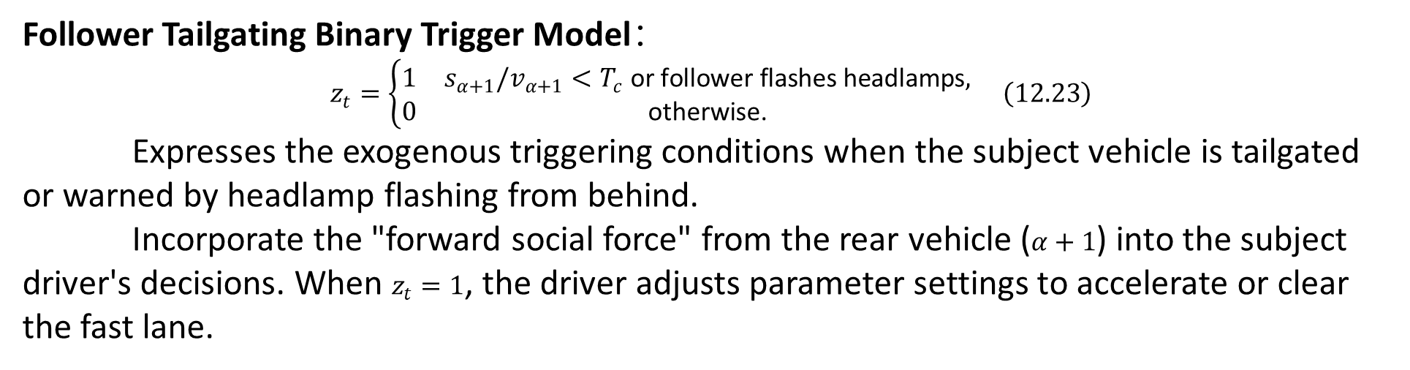
12.6 Brake Lights and Further Exogenous Factors
Follower Tailgating Binary Trigger Model$：$
$$z_{t}=\left\{\begin{matrix}1 & s_{α+1}/v_{α+1}<T_{c}\text{ or follower flashes headlamps}, \\ 0 & \text{otherwise.}\end{matrix}\right. \left(12.23\right)$$
Expresses the exogenous triggering conditions when the subject vehicle is tailgated or warned by headlamp flashing from behind.
Incorporate the "forward social force" from the rear vehicle ($α+1$) into the subject driver's decisions. When $z_{t}=1$, the driver adjusts parameter settings to accelerate or clear the fast lane.
rhodeskesi

Slide 22
12.7 Local Traffic Context
  When driving for extended periods in congested or jammed traffic, driver alertness decreases, leading to reduced acceleration and increased time gaps.
  This reduced driving efficiency induced by cognitive fatigue is called the resignation effect or memory effect.
  The resignation effect causes the discharge flow downstream of a bottleneck to be significantly lower than pre-breakdown capacity, representing the classic capacity drop phenomenon in traffic physics.
  In addition, local traffic context encompasses dynamic parameter adjustments driven by exogenous factors such as variable speed limit zones, roadworks, tunnels, adverse weather, and transitions between urban and freeway environments.
rhodeskesi

Slide 23
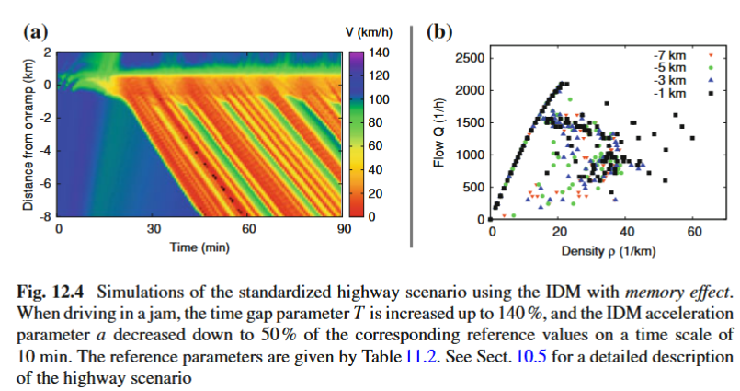
12.7 Local Traffic Context
  Dual Time Scales of Parameter Adaptation：
  Gradual changes occur over minutes (e.g., 10 min) driven by memory effects or changing weather conditions.
  Instantaneous changes occur immediately when passing speed limit signs, entering/leaving tunnels, roadworks, or city limits.
rhodeskesi

Slide 24
12.8 Action Points
  All previous models assumed drivers react to any tiny environmental change in a continuous way.
  Physio-psychological studies show humans have finite perception thresholds in discriminating gaps, speeds, or relative speeds.
  Drivers do not adjust pedals continuously; they maintain constant acceleration most of the time, adjusting discretely only when deviating beyond thresholds.
  These discrete time instances triggering conscious control actions are defined as action points.
  Trajectory data show action-point intervals, thresholds, and adjustments are stochastic, making them hard to distinguish from acceleration noise, leaving their existence controversial.
rhodeskesi

Slide 25
12.9 The Wiedemann Car-Following Model
  Four Discrete Driving Regimes：
  Free flow regime: The driver is unobstructed by leading vehicles, cruising at the desired speed.
  Approaching slower vehicles regime: The driver detects a slower leader and actively decelerates to match speed and build a safe gap.
  Car-following near steady-state equilibrium regime: The driver fluctuates near equilibrium, making minor adjustments around the target gap and relative speed.
  Critical situations requiring stronger braking actions regime: Gap is too small or approach speed too high, triggering hard braking to prevent a crash.
rhodeskesi

Slide 26
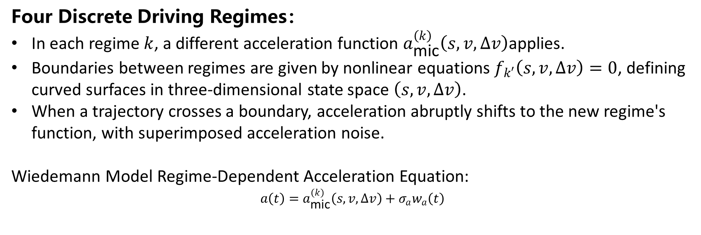
12.9 The Wiedemann Car-Following Model
  Four Discrete Driving Regimes：
  In each regime $k$, a different acceleration function $a_{\text{mic}}^{\left(k\right)}\left(s,v,Δv\right)$applies.
  Boundaries between regimes are given by nonlinear equations $f_{k′}\left(s,v,Δv\right)=0$, defining curved surfaces in three-dimensional state space $\left(s,v,Δv\right)$.
  When a trajectory crosses a boundary, acceleration abruptly shifts to the new regime's function, with superimposed acceleration noise.
  Wiedemann Model Regime-Dependent Acceleration Equation:
  $$a\left(t\right)=a_{\text{mic}}^{\left(k\right)}\left(s,v,Δv\right)+σ_{a}w_{a}\left(t\right)$$
rhodeskesi

Slide 27
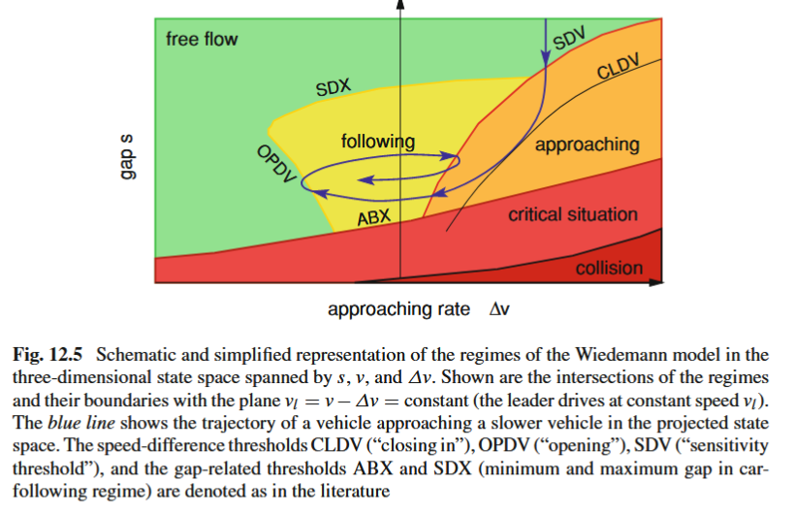
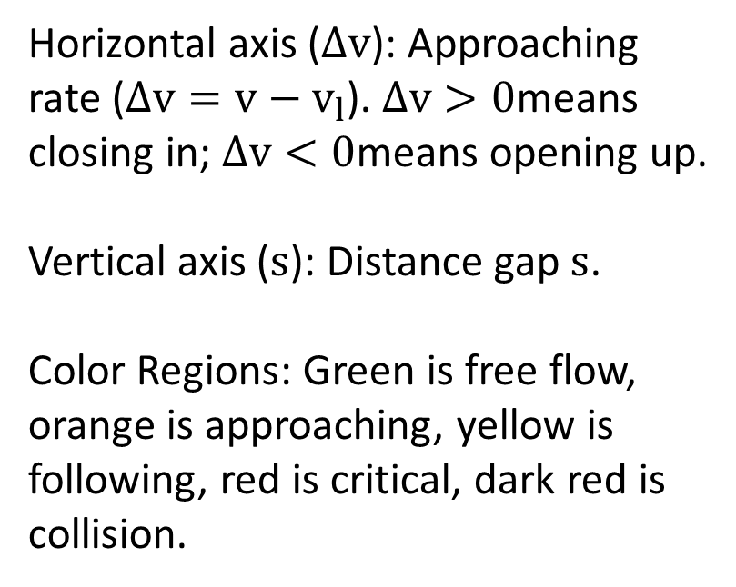
12.9 The Wiedemann Car-Following Model
rhodeskesi
  Horizontal axis ($Δv$): Approaching rate ($Δv=v−v_{l}$). $Δv>0$means closing in; $Δv<0$means opening up.
  Vertical axis ($s$): Distance gap $s$.
  Color Regions: Green is free flow, orange is approaching, yellow is following, red is critical, dark red is collision.

Slide 28
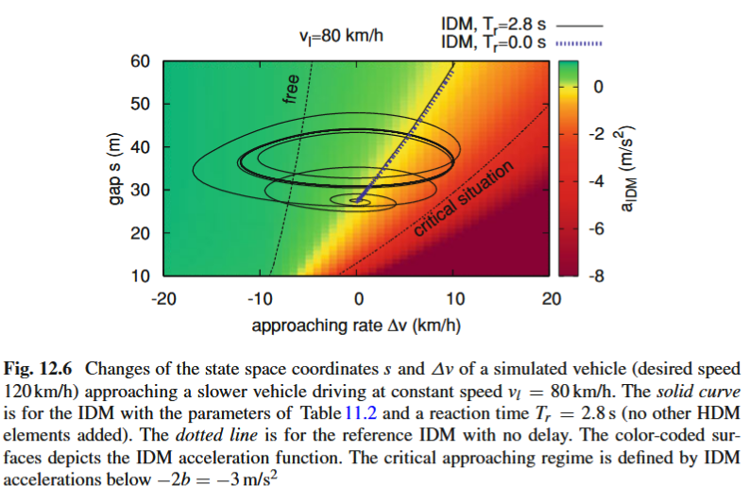
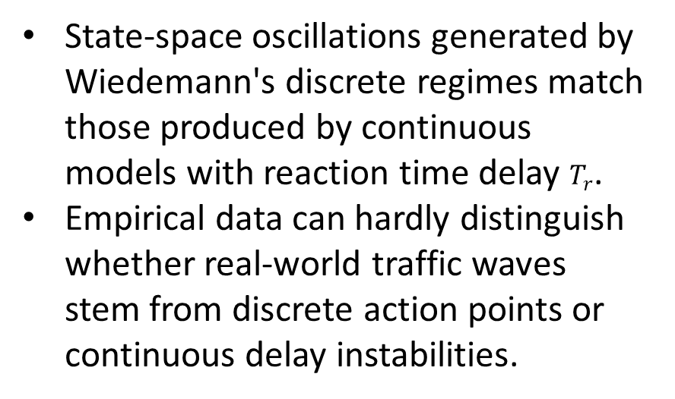
12.9 The Wiedemann Car-Following Model
rhodeskesi
  State-space oscillations generated by Wiedemann's discrete regimes match those produced by continuous models with reaction time delay $T_{r}$.
  Empirical data can hardly distinguish whether real-world traffic waves stem from discrete action points or continuous delay instabilities.

